Slide 1

Nhân bản – Phụng sự – Khai phóng
KHOA KỸ THUẬT MÁY TÍNH VÀ ĐIỆN TỬ
GRADUATION THESIS
BUILDING AN ENTERPRISE NETWORK SYSTEM WITH AUTOMATION USING ANSIBLE, MONITORING WITH PROMETHEUS, AND SECURITY WITH PFSENSE IDS/IPS
Student Name: Nguyen An Phuc
Student ID: 21IT639
Supervisor: Dr. Dang Quang Hien
Đà nẵng, tháng 1 năm 2026

Slide 2

OUTLINE
Introduction & Objectives
Core Technologies
Network Topology Design
System Data Flow
System Implementation
Experimental Results
Evaluation & Future Development
Conclusion
Faculty of Computer Engineering and Electronics
Page 2/18

Slide 3
1. INTRODUCTION & OBJECTIVES
1. Context & Challenges:
2. NetDevOps Solution:
3. Research Objectives:
Manual Administration: Time-consuming, prone to human errors during repetitive tasks.
Lack of Centralized Monitoring: Difficult to identify the root cause of incidents; scattered data.
Passive Security: Traditional routers/firewalls fail to prevent high-speed automated attacks.
Combining Network + DevOps (Infrastructure as Code).
Automated Administration – Active Monitoring – Proactive Security.
Infrastructure: Secure Network Zoning (DMZ, LAN, WAN).
Automation: Automated Configuration Backup, Agent Deployment (Ansible, Python).
Monitoring: Centralized Metrics & Logs (Prometheus, Grafana).
Faculty of Computer Engineering and Electronics
Page 3/18

Slide 4


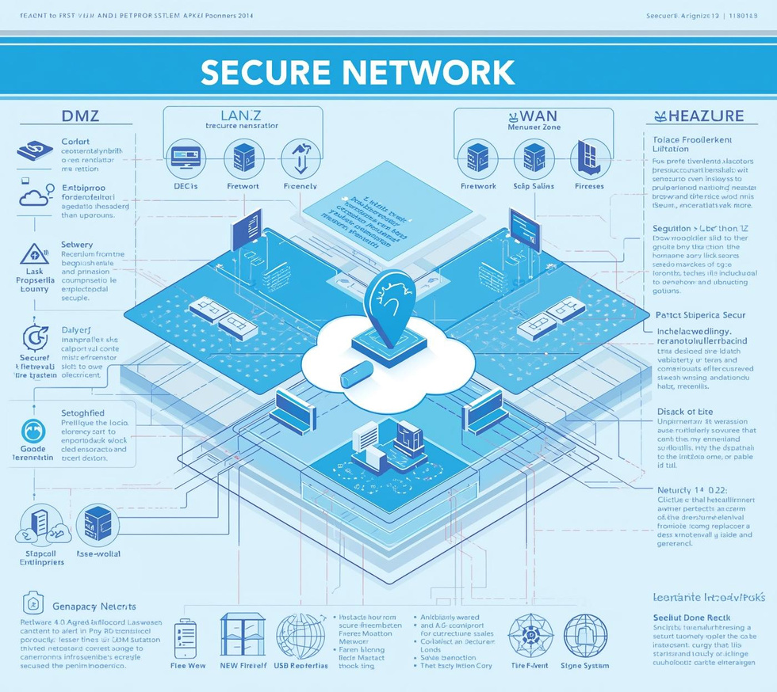
2. CORE TECHNOLOGIES
Automation
Infrastructure & Security
Ansible: Agentless configuration management, utilizing SSH.
Teleport: Secure remote access, replacing traditional SSH, session recording.
pfSense: Open-source Router/Firewall.
Suricata: Intrusion Detection and Prevention System .
Docker/GNS3: Virtualization and simulation environments.
Monitoring & Logging
Prometheus: Metric collection (CPU, RAM, Traffic).
Grafana: Data visualization (Dashboards).
Loki & Promtail: Centralized log aggregation and querying.
Faculty of Computer Engineering and Electronics
Page 4/18

Slide 5
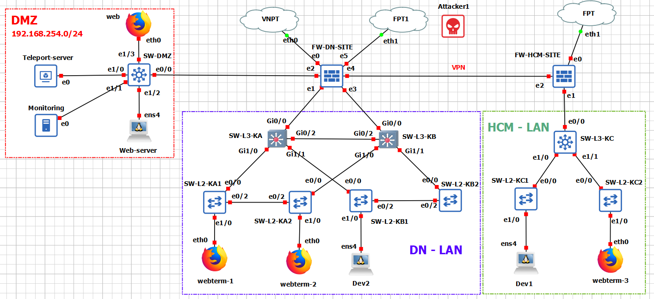
3. NETWORK TOPOLOGY DESIGN
1. Zoning Architecture:
WAN: Internet Connection (NAT).
DMZ: Public Services (Web, Mail, Proxy).
LAN: Internal Users (Staff, Guest, Tech, Manager).
2. Infrastructure Components:
pfSense: Central Gateway, Firewall, NAT, HAProxy, Suricata.
Network Devices: Cisco L3/L2 Switches.
Servers: Linux (Ubuntu/Debian).
Page 2/16
Faculty of Computer Engineering and Electronics
Page 5/18

Slide 6
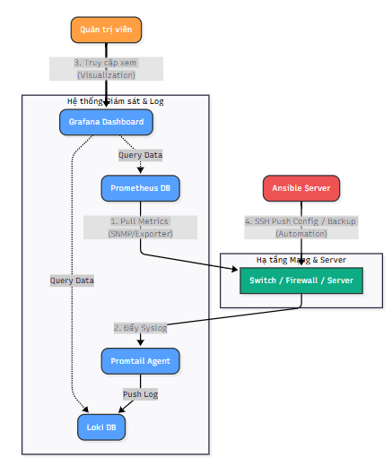
4. SYSTEM DATA FLOW
1. Monitoring Flow (Metric):
- Target (SNMP) -> Prometheus (Pull) -> Alertmanager.
2. Logging Flow (Logs):
- Device (Syslog) -> Promtail -> Loki (Storage).
3. Visualization Flow:
- User -> Grafana Dashboard -> Query Data.
4. Automation Flow:
- Ansible -> SSH -> Network Devices (Config/Backup).
Faculty of Computer Engineering and Electronics
Page 2/16
Faculty of Computer Engineering and Electronics
Page 6/18

Slide 7
5. NETWORK INFRASTRUCTURE & SECURITY IMPLEMENTATION
1. Switch Configuration (Cisco):
VLAN & Trunking: Network segmentation, 802.1Q Trunking.
OSPF: Dynamic routing, automatic route updates.
HSRP: Gateway Redundancy (Active/Standby), ensuring High Availability.
Page 2/16
Faculty of Computer Engineering and Electronics
Page 7/18

Slide 8
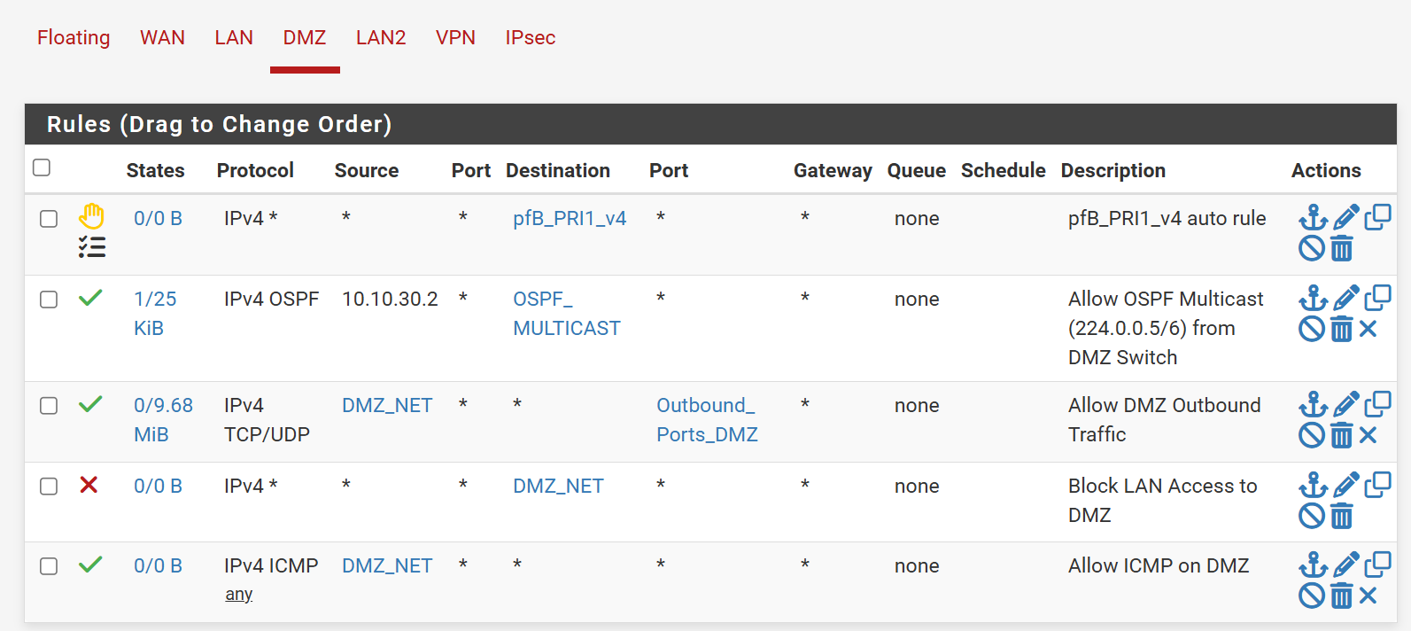
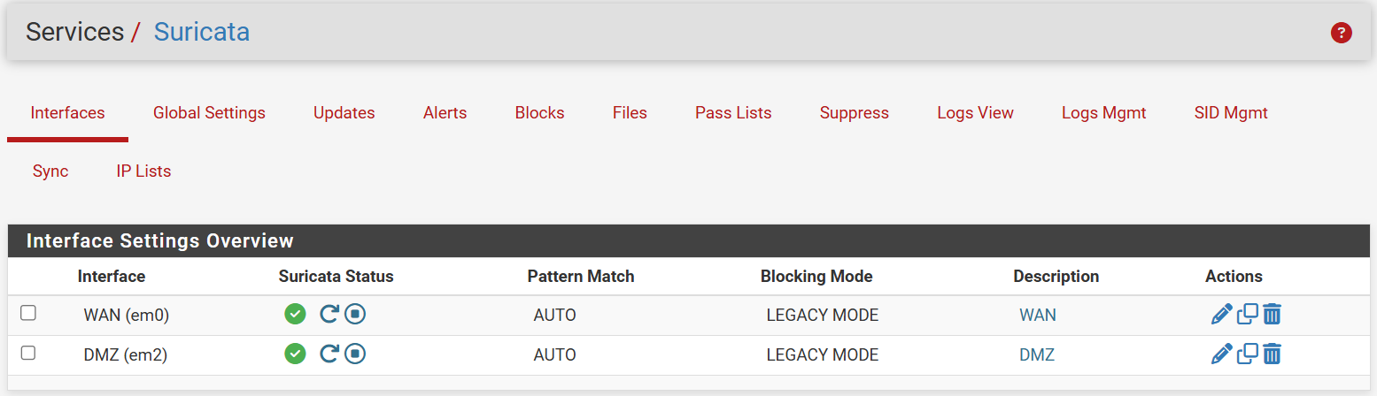
5. NETWORK INFRASTRUCTURE & SECURITY IMPLEMENTATION
2. Security with pfSense & Suricata IPS:
Firewall & Proxy:
Strict Zoning Rules: Segmentation between LAN - DMZ - WAN.
NAT Configuration: Enable Internet access for internal networks.
HAProxy: Reverse Proxy & SSL Offloading for internal server protection.
Intrusion Prevention (Suricata):
Mode: IPS (Legacy Mode) – Inline traffic inspection.
Action: Automatically Drop Packet & Block Offenders based on ETOpen rulesets.
Page 2/16
Faculty of Computer Engineering and Electronics
Page 8/16

Slide 9
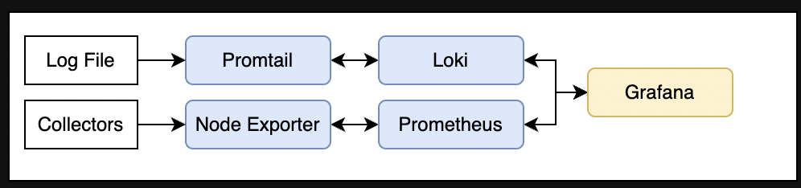
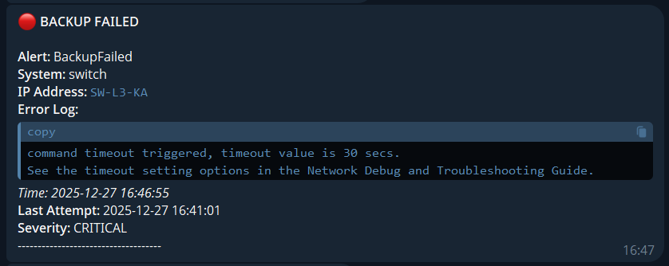
6. MONITORING SYSTEM IMPLEMENTATION (PLG STACK)
Docker Compose Architecture:
5 Containers: Prometheus, Alertmanager, Loki, Promtail, Grafana.
Observability Capabilities:
Network: Bandwidth usage, Port status (UP/DOWN).
System: Server resources (CPU, RAM, Disk).
Logs: Centralized Syslog from Cisco, pfSense, Nginx.
Alerting:
Channel: Telegram.
Triggers: Port Down, High Latency, Backup Failed.
Faculty of Computer Engineering and Electronics
Page 2/16
Faculty of Computer Engineering and Electronics
Page 9/18

Slide 10
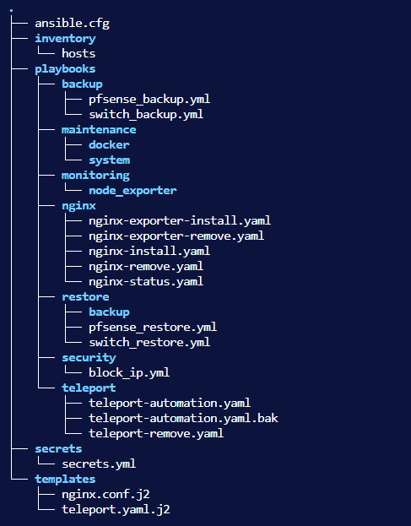
7. AUTOMATION IMPLEMENTATION (ANSIBLE & TELEPORT)
1. Ansible Playbooks:
switch_backup.yml: Automates periodic configuration backups for Cisco Switches.
pfsense_backup.yml: Retrieves and backs up pfSense XML configuration files.
2. Provisioning & Deployment:
teleport-automation.yml: Auto-provisions Teleport Agents for secure remote access.
Tool Installation: Automated deployment of essential tools (Docker, Node Exporter, Promtail) ensuring environment consistency.
Faculty of Computer Engineering and Electronics
Page 2/16
Faculty of Computer Engineering and Electronics
Page 10/18

Slide 11
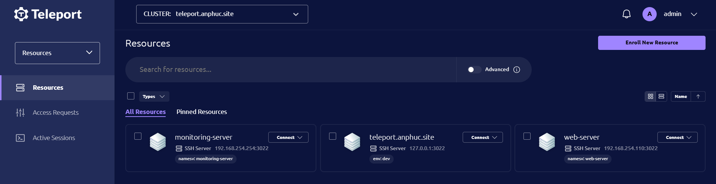
7. AUTOMATION IMPLEMENTATION (ANSIBLE & TELEPORT)
Access Management with Teleport:
Replaces traditional SSH Keys (reducing security risks).
Session-based access control.
Audit Log: Records all administrator commands and sessions.
Faculty of Computer Engineering and Electronics
Page 2/16
Faculty of Computer Engineering and Electronics
Page 11/18

Slide 12
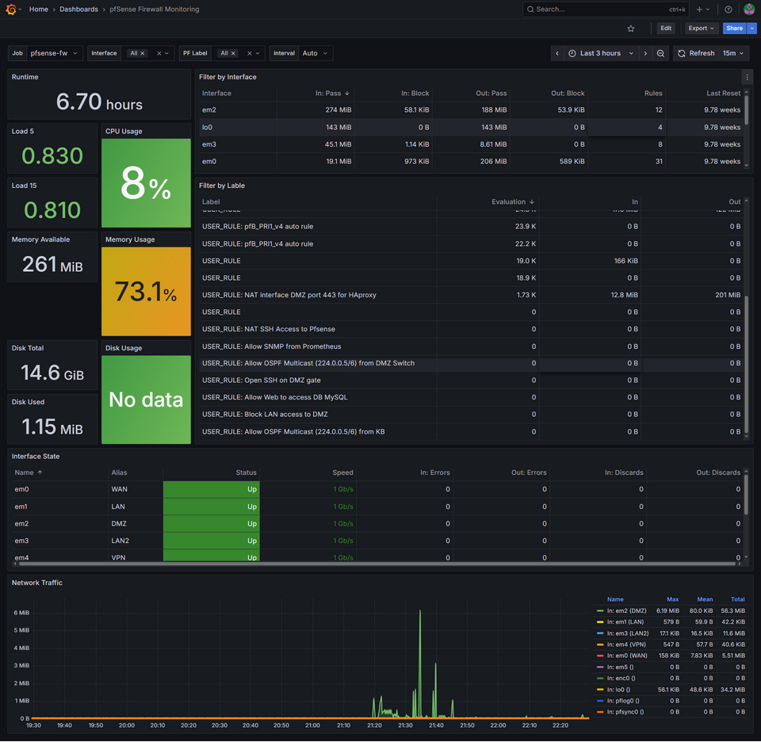
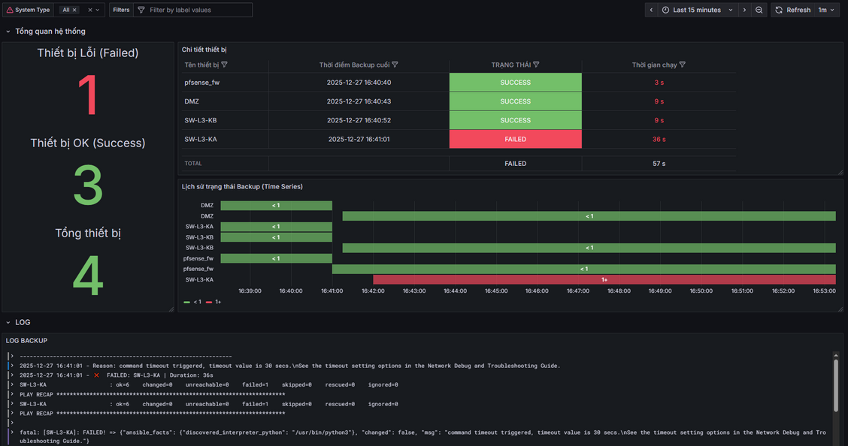
8. EXPERIMENTAL RESULTS
1. Real-time Dashboard (Grafana):
Centralized Dashboard: Visualizes network traffic and aggregated logs.
Backup Status: Real-time tracking of backup completion and health.
Traffic Visibility: Granular insights into traffic patterns and flows.
Faculty of Computer Engineering and Electronics
Page 2/16
Faculty of Computer Engineering and Electronics
Page 12/18

Slide 13
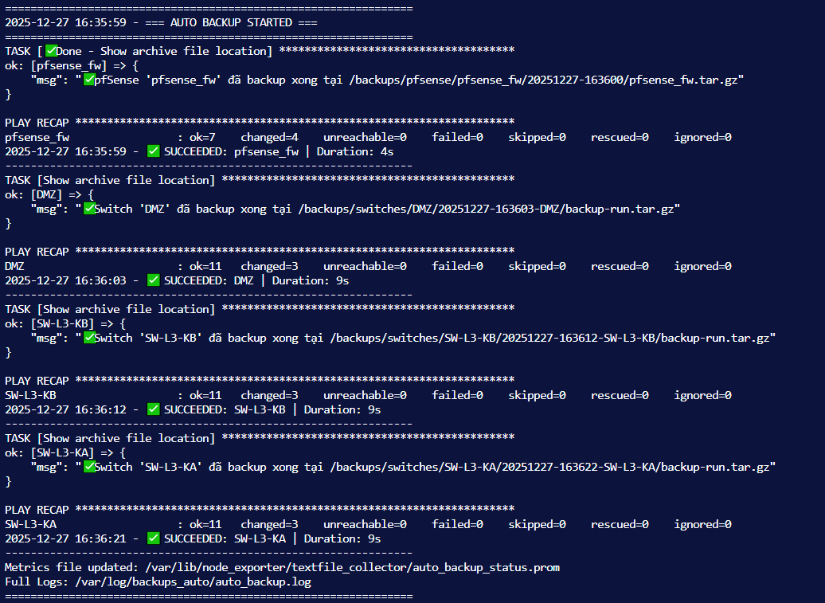
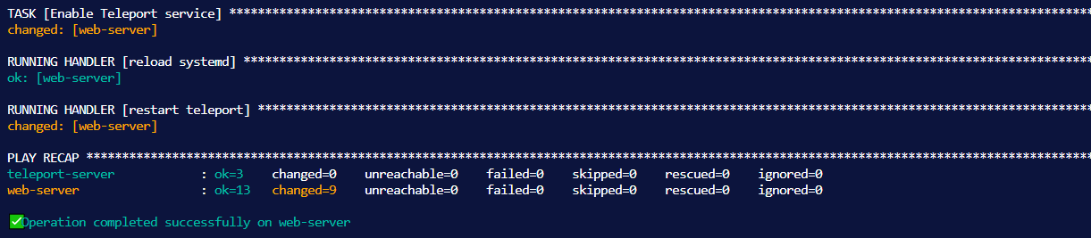
8. EXPERIMENTAL RESULTS
2. Automation Capabilities:
Scheduled Backups: Executes configuration backups precisely at 02:00 AM daily.
Agent Provisioning: Automated setup of Teleport agents for all devices.
Rapid Deployment: Quick installation and configuration of Docker environments.
Faculty of Computer Engineering and Electronics
Page 2/16
Faculty of Computer Engineering and Electronics
Page 13/18

Slide 14
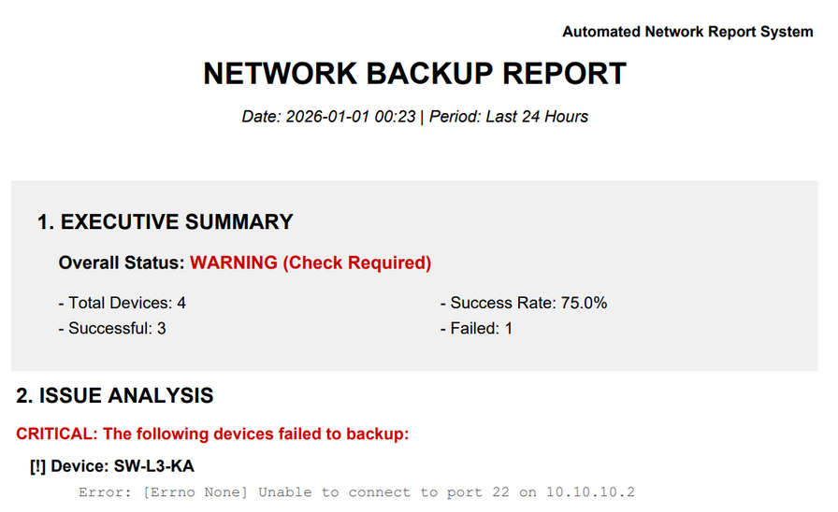
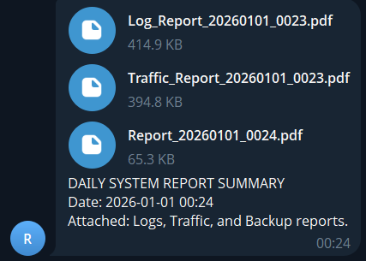
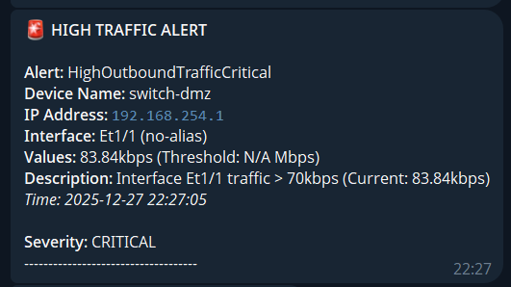
8. EXPERIMENTAL RESULTS
3. Automated Alerting & Reporting:
Precision Alerting: Instant, accurate notifications triggered by system events.
Daily Reporting: Automated PDF system health reports sent via Telegram.
Faculty of Computer Engineering and Electronics
Page 2/16
Faculty of Computer Engineering and Electronics
Page 14/18

Slide 15
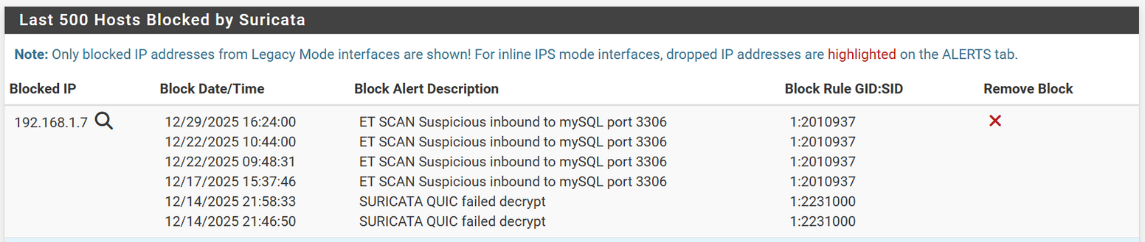
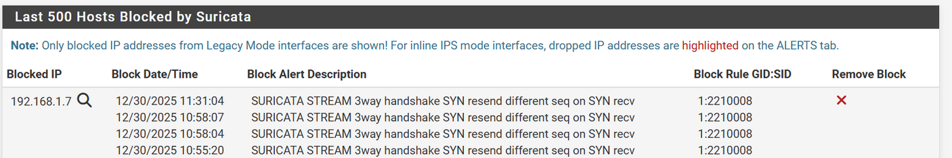
8. EXPERIMENTAL RESULTS
4. Attack & Prevention Scenarios (Suricata):
Nmap Scan: Suricata detects scan signature -> Blocks IP.
DoS Attack (Hping3): Detects SYN Flood -> Drops connection.
Result: Web remains accessible and stable.
Faculty of Computer Engineering and Electronics
Page 2/16
Faculty of Computer Engineering and Electronics
Page 15/18

Slide 16

9. EVALUATION & FUTURE DEVELOPMENT
Advantages:
Comprehensive: Covers Administration - Monitoring - Security.
Cost-effective: 100% Open Source software.
Proactive: Fast incident response and resolution.
Limitations:
Tested on Small/Medium scale (SMB).
Defense capabilities require further tuning for large-scale attacks.
Future Development:
Integrate AI/ML for Log Analysis (Anomaly Detection).
Expand to Kubernetes Cluster for scalability.
Faculty of Computer Engineering and Electronics
Page 2/16
Faculty of Computer Engineering and Electronics
Page 16/18

Slide 17
10. CONCLUSION
1. Technical Achievements:
Successfully realized a comprehensive NetDevOps model.
Stable operation across Automation, Monitoring, and Security layers.
2. Economic & Management Efficiency:
Cost Optimization: No licensing fees (Open Source).
Productivity: Reduced manual workload, eliminated human errors via Ansible.
3. Applicability:
High feasibility for SMBs (Small and Medium-sized Businesses).
Scalable Architecture: Modular design (Docker) allows for easy expansion.
Faculty of Computer Engineering and Electronics
Page 2/16
Faculty of Computer Engineering and Electronics
Page 17/18

Slide 18

Nhân bản – Phụng sự – Khai phóng
Thank You!
Faculty of Computer Engineering and Electronics
Page 18/18

